Slide 1


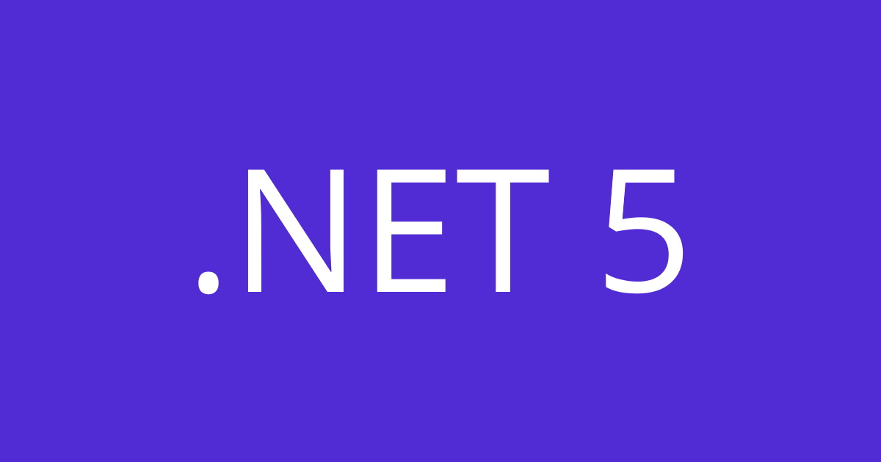
Build High Performance Services
With gRPC and .NET 5

Slide 2
Table of contents
Introduction to gRPC
Manage Protobuf references
Deadlines and Cancellation
Authentication & Authorization
Security considerations in gRPC
Transient fault handling
Test gRPC services with gRPCurl

Slide 3
Introduction to gRPC
Service definition
gRPC uses the Protocol Buffers(protobuf) as Interface Definition Language(IDL)
Metadata
Information about a particular RPC call in form of key-values
Channels
Provides a connection to a gRPC server on a specified host and port
Communication Patterns
Unary, Server Streaming, Client Streaming, Bidirectional Streaming

Slide 4
Introduction to gRPC
Create a .proto file with the definitions for the request message, the response message, and the service interface
1
.proto
1
protoc
Compile the .proto file to generate the gRPC code for the server and the gRPC code for the client for the chosen language
2
2
Extend the gRPC Server code to implement and build the service provider
gRPC Stub
gRPC Server
3
3
4
Extend the gRPC Stub code to implement and build the service consumer
Http/2
4
Introduction to gRPC |polarsparc.com

Slide 5
Introduction to gRPC
Client
Unary
Server
Client Streaming
Client
Server
Client
Server Streaming
Server
Client
Bidi Streaming
Server

Slide 6
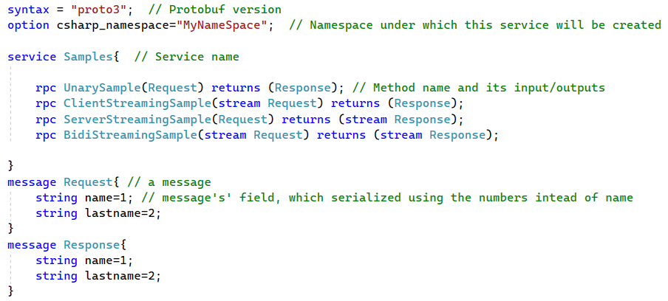
Introduction to gRPC

Slide 7

Manage Protobuf references
proto file can be added to server/client projects in various ways such as:
Adding file directly to each project(sync problem)
Using code first approach(polyglot projects problem)
Adding gRPC service reference to each projects
Read More: Protocol Buffers | Google Developers

Slide 8
Deadlines and Cancellation
A deadline allows a gRPC client to specify how long it will wait for a call to complete
When a deadline is exceeded:
For Client: DeadlineExceeded exception have been thrown and the request aborted
For Server: ServerCallContext.CancellationToken raised and the request aborted
Deadlines can be propagated:
Manually: by passing ServerCallContext.Deadline
Automatically: by using EnableCallContextPropagation() in Client Factory
Client
gRPC-1
gRPC-2

Slide 9

Deadlines and Cancellation
Cancellation allows a gRPC client to cancel long running calls that are no longer needed
Request can be cancelled:
By setting CallOptions.CancellationToken
By calling Dispose on the call

Slide 10
Authentication & Authorization
gRPC can be used with ASP.NET Core authentication to associate a user with each call
Once authentication has been setup, the user can be accessed in a gRPC service methods via the ServerCallContext
gRPC client factory can create clients that send a Bearer token using ChannelCredentials.

Slide 11
Security considerations in gRPC
Transport security
It is recommended to use TLS in production environment
Exceptions
Detailed exception messages shouldn't be exposed to the client in production apps.
Message size limits
By default, gRPC limits incoming messages to 4MB. There is no limit on outgoing messages
Limits can also be configured for an individual services too

Slide 12

Transient fault handling
gRPC calls can be interrupted by transient faults. Transient faults include:
Momentary loss of network connectivity.
Temporary unavailability of a service.
Timeouts due to server load.
Retries strategies:
Using RetryPolicy: Resend the request based on backoff delays
Using Hedging: Aggressively sending multiple copies of a single request

Slide 13
Test gRPC services with gRPCurl
Tooling is available for gRPC that allows developers to test services without building client apps:
gRPCurl: Command-line tool that provides interaction with gRPC services
gRPCui: Builds on top of gRPCurl and adds an interactive web UI for gRPC
gRPCurl must know the Protobuf contract of services before it can call them:
Setting up gRPC reflection on the server.
Specify .proto files in command-line arguments to gRPCurl.
Command-line tool for interacting with gRPC servers | GitHub.com

Slide 14
Some useful links
gRPC Documentation | grpc.io
gRPC-Gateway | grpc-ecosystem.github.io
Introduction to gRPC on .NET | Microsoft Docs
gRPC for .NET | github.com
Logging gRPC requests using Serilog | gsferreira.com
Getting Started with gRPC Client Factory | stevejgordon.co.uk

Slide 15
How to Contact me
Twitter: @_Jinget
LinkedIn: VFarahmandian
GitHub: VahidFarahmandian
Email: farahmandian2011@gmail.com

